Slide 1
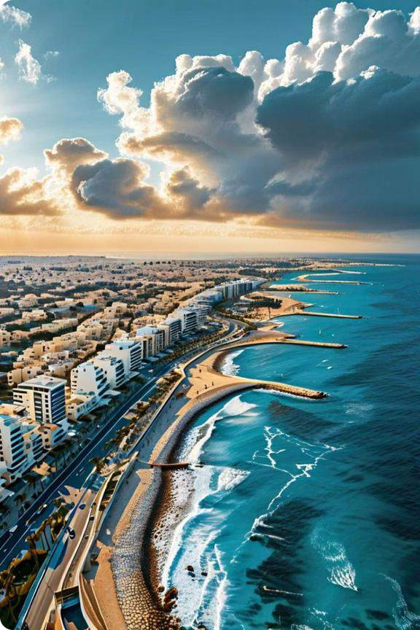
On the Frontline of Survival: Israel's
Forceful Future

Slide 2
Navigating Geopolitical Tensions
Iran's Nuclear Ambitions
Antagonistic Relations
Disruptive Sea Activities
Iran's pursuit of nuclear capabilities has heightened tensions with Israel, creating a precarious regional dynamic with global implications.
The antagonistic relationship relationship between Iran and and Israel, fueled by ideological differences and regional power struggles, has has contributed to a state of constant alert.
Iran's activities at sea, including potential disruption disruption of maritime security, pose additional challenges to the stability of the region.

Slide 3
Strengthening Regional Cooperation
1
Combating Terrorism
Israel's collaboration with nations in the Horn of Africa aims to counter the threat of terrorism and piracy in the region.
2
Mitigating Instability
Addressing shared concerns and emerging threats through regional cooperation is crucial for promoting stability in the interconnected regions. regions.
3
Securing Mutual Interests
The strategic significance of the Horn of Africa in fostering collaboration
between Israel and regional entities cannot be overstated.

Slide 4
Confronting Emerging Threats
1
Potential Coalition Efforts
Collective efforts directed against Israel have generated alarms and raised concerns about their implications implications for regional regional stability.
2
Geopolitical Ramifications
Understanding the possibilities and ramifications of such a coalition is essential in navigating the complex web of relationships and and interests in the region.
3
Anticipating Future Scenarios
Exploring the possibilities of Russia's role, whether as a mediator or a future adversary, is crucial in shaping Israel's strategic strategic response.

Slide 5
The Persistent Threat of Terrorism
Religious and Political
Political Ideologies
The geopolitical position of of the Middle East is shaped by both religion and politics, influencing international order.
Volatile Regional
Dynamics
Mounting threats from Iran and its proxies, along with Israel's defensive actions, continue to deliver volatile relations throughout the region.
Pursuit of Peace and
Stability
While cooperation between between state and non- state parties in the region is is preferred, the journey towards peace and stability stability is fraught with challenges.

Slide 6
Israel's Strategic Alliances
Countering Regional Threats
Securing the Horn of Africa
Promoting Mutual Interests
Israel recognizes the value of of forging alliances and bolstering cooperation with nations in the region to address shared concerns and and emerging threats.
The strategic significance of the Horn of Africa in fostering fostering collaboration between Israel and regional entities for security purposes purposes is crucial.
From combating terrorism and piracy to mitigating regional instability, the collaboration between Israel and the Horn of Africa nations nations is a vital pillar in safeguarding mutual interests.

Slide 7
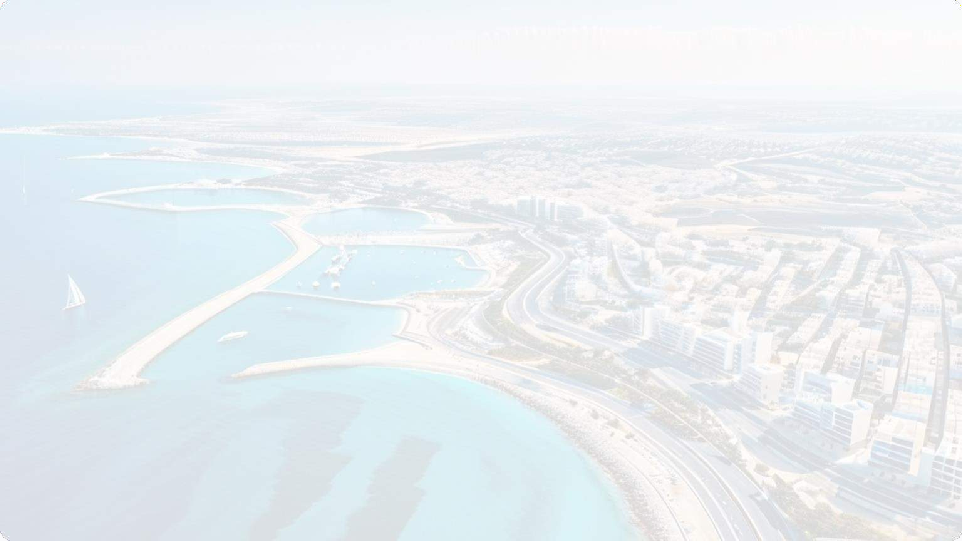
Navigating an Uncertain Future
Resilience and
Determination
Israel's existence stands as a testament to its resilience and determination, as it navigates the forefront of survival amidst complex challenges.
Global Attention
The future of Israel unfolds on the frontline, where the forceful currents of geopolitics converge, attracting the keen interest of of the world.
Pivotal Crossroads
Positioned at the crossroads crossroads of Africa, the Middle East, and the Red Sea, the Horn of Africa serves as a pivotal nexus for geopolitics and security.

Slide 8
Fostering Regional Stability
Cooperation
Collective efforts and cooperation between state and and non-state parties in the region are preferred for promoting peace and stability. stability.
Diplomacy
Navigating the complex web of of relationships and interests in in the Middle East requires a diplomatic approach to address address the region's challenges.
Security
Enhancing regional security through strategic alliances and and collaborative efforts is crucial for safeguarding the interests of Israel and its allies. allies.

Slide 9
Iran's Ballistic Missile Missile Buildup

Slide 10
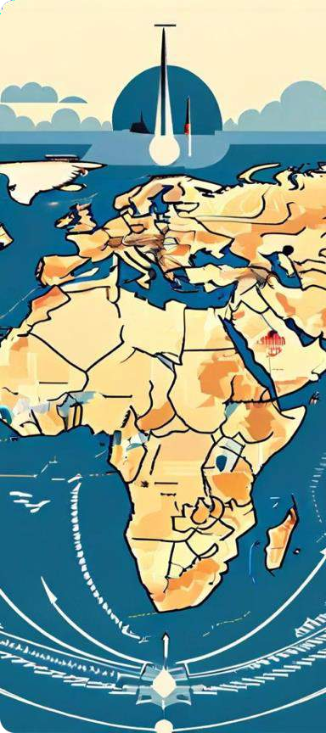
Targeting Israel
1
Anti-Israel Agenda
Iran's leaders have made strong anti-Israel statements and support proxies like Hamas and Hezbollah that oppose Israel's existence.
2
Potential Threat
The fear is that Israel is a more likely target of Iran's missiles than neighbouring countries, exacerbating tensions in the Middle East.
3
Libyan Weapons
Libya has become a source of weapons, mostly for targeting Israel, with Libyan
rockets smuggled into Gaza and Iranian-produced missiles found in Libya.

Slide 11
Iran's Missile Capabilities
Short-Range Rockets
Ballistic Missiles
Medium-Range Missiles
Iran has tactical rockets like Zelzal that were transferred to to Hezbollah before the 2006 2006 war.
Iran's Fateh-110 missile has a circular error probable of just 5 metres, demonstrating its precision.
Iran's Shahab-3 missile can reach targets up to 1,240 miles, potentially including Israel.

Slide 12
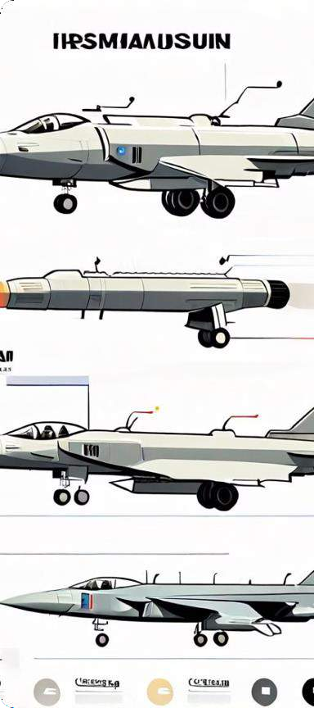
Acquiring Missile Technology
North Korean Missiles
Iran has acquired BM-25 surface-to- surface missiles from North Korea, with with a range of 1,550 miles.
Hwasong-15 ICBM
Iran has also obtained the Hwasong- 15, a North Korean intercontinental ballistic missile capable of reaching the the US.
Musudan Missile
There are reports of Iran potentially acquiring or having access to modified versions of versions of the Musudan medium-range ballistic missile from North Korea.

Slide 13
Implications for Israel
1
Conventional Deterrent
Iran and its proxies have demonstrated a substantial conventional deterrent capability against Israel, the US, and other adversaries.
2
Yemen as a Launch Site
Short-range missiles fired from Yemen are more economical, allowing for
for larger quantities for extensive barrages.
3
Precision Challenges
Iran's precision-guided missiles pose a significant challenge for Israel's
missile defence systems like Iron Dome.

Slide 14
Missile Proliferation
North Korea
North Korea supports Iran's missile programme, providing providing technology and expertise.
Russia
Russia also collaborates with Iran, contributing to the development of its missile capabilities.
Libya
Libya has become a source of illicit weapons, including those those targeting Israel.

Slide 15
Escalating Tensions
Threatening Rhetoric
Iran and its proxies continue continue to issue threatening threatening rhetoric towards towards Israel and other adversaries.
Deadly Strikes
The introduction of more accurate and powerful missiles makes strikes against Israel deadlier.
Regional Instability
The build-up of weapons in the Middle East, by both governments and terrorist groups, contributes to regional instability.

Slide 16
Conclusion
Key Takeaways
- Iran's ballistic missile programme has a significant anti-Israel agenda
- Iran has acquired advanced missile technology from North Korea and Russia
- Iran's precision-guided missiles pose a growing challenge for Israel's missile defence systems
- The proliferation of deadly weapons in the Middle East is escalating regional tensions

Slide 17
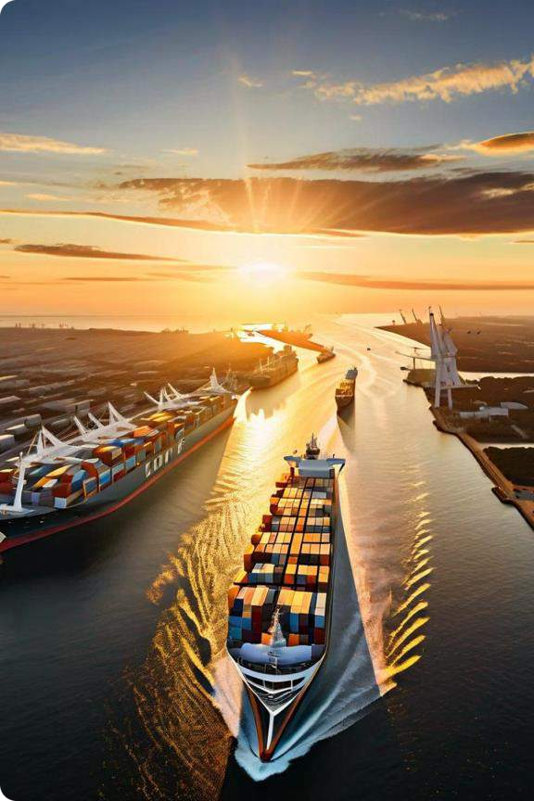
Iran's Activities at Sea

Slide 18
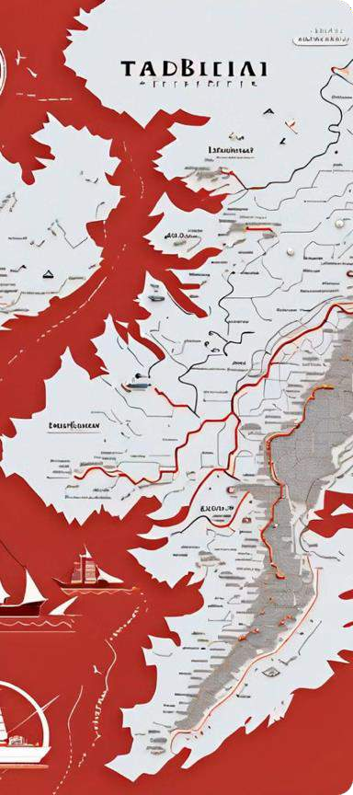
Securing the Bab El-Mandeb Strait
1
Houthi Rebels
Iran sponsors the Houthi rebels to consolidate control over the Bab El- Mandeb Strait.
2
Strategic Imperative
Securing dominance over the Red Sea necessitates Iran's effective control
of the Bab El-Mandeb Strait.
3
Sejil Missile
Iran's Sejil Missile, with a 180 km range, can be launched from Yemen to
reach any point in the Red Sea.

Slide 19
Influence in the Suez Canal
Geopolitical
Considerations
Economic Interests
Assertive Stance
The Suez Canal is a critical waterway for international trade, including the transportation of goods to and from Iran.
Iran's assertive stance in the Suez Canal includes the passage of Iranian ships in 2011 and 2012.
Iran's relationship with ships navigating the Suez Canal is defined by geopolitical interests.

Slide 20
Control over the Strait of Hormuz
Strategic Chokepoint
Iran holds substantial influence over the Strait Strait of Hormuz, a critical maritime chokepoint for global oil supply.
Geopolitical Leverage
Iran's control and influence in the Strait of Hormuz afford it considerable leverage in global energy markets and regional dynamics.
Naval Capabilities
Iran's naval capabilities, including the IRGC Navy, reinforce its position of influence in the the Strait of Hormuz.
Assertive Behavior
Iran has occasionally threatened to block or or disrupt the passage of vessels through the the Strait of Hormuz as a geopolitical tool.

Slide 21
Aggression in the Gulf of Aden
1
Vital Waterway
The Gulf of Aden serves as a crucial maritime route for global trade, including energy resources.
2
Houthi Support
Iran's support for Houthi rebels in Yemen has exacerbated tensions and conflicts in the region.
3
Arms Smuggling
Iran's alleged arms smuggling and support support for insurgent groups have contributed to regional instability.
4
Oil Smuggling
The IRGC engages in oil smuggling to Somalia, supporting militants in Yemen and and Somalia.

Slide 22
Targeting Israel's Security
Karine A
In 2002, Israel Navy Seals seized a freighter carrying 50 tons of high-grade Iranian weapons.
Calypso and Santorini
Israel successfully captured ships attempting to smuggle arms from Lebanon to Gaza.
Francop and Victoria
Israel intercepted ships carrying Iranian weapons destined for Hezbollah and Hamas terrorists.

Slide 23
Challenges in Interdicting Warships
International Laws
Israel risks falling foul of international laws regarding free and safe passage
passage on the high seas.
Immunity for Iran
This international rule gives Iran's navies a kind of immunity, bolstering Iran's Iran's strategy in the Red Sea.
Defending Itself
While defending itself, Israel seizes arms bound for terrorist groups in nearby nearby territories.

Slide 24
Securing Sea Lanes
Trade Routes | Coastal Patrols | Oil Transport
Unhindered trade routes are | Sea lanes are used by many | The Red Sea is a vital route
are essential for prospering | nations' naval vessels for the | for the transportation of oil
industrial nations. | patrol of coastal regions. | through Bab El-Mandeb to
 |  | the Suez Canal.

Slide 25
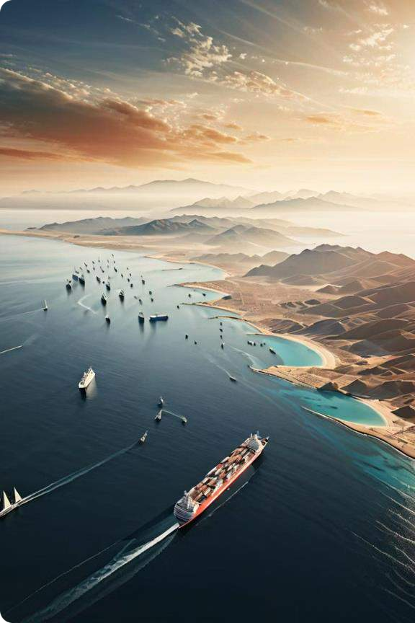
Iran's Red Sea Strategy
Iran seeks to exert influence in the Red Sea region to control oil flow and and disrupt Israel. It aims to gain sway in Yemen, the Horn of Africa, and and other strategic locations.

Slide 26
Controlling the Red Sea Entrance
1
Yemen
Iran supports its proxy in Yemen to gain control of the southern Red Sea entrance.
2
Horn of Africa
Iran seeks influence in Eritrea, Somalia, Sudan, and Ethiopia to further its
regional ambitions.
3
Suez Canal
Controlling the Red Sea entrance would allow Iran to threaten the Suez
Canal, a crucial global trade route.

Slide 27
Iran's Influence in the Horn
Eritrea
Sudan
Ethiopia
Iran has supported Eritrea in delivering arms to Al-Shabab Shabab in Somalia.
Iranian warships have docked at Port Sudan, demonstrating Iran's interest in the region.
Iran supports Ethiopia against against the Tigray Defense Forces, enhancing its strategic influence.

Slide 28
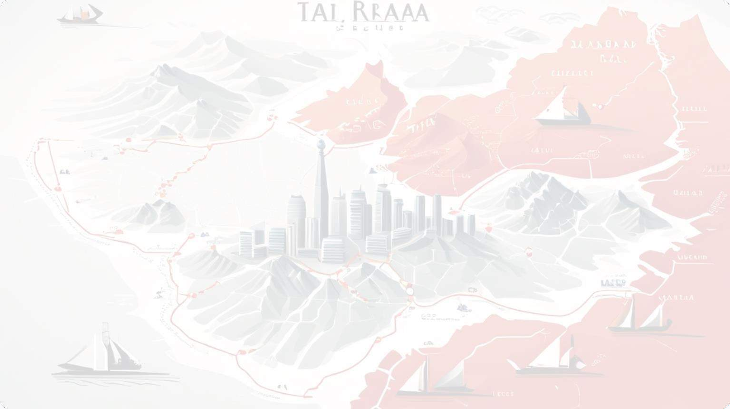
Saudi Arabia's Regional Role
1
Mediator
Saudi Arabia has facilitated a peace agreement between Eritrea and Ethiopia.
2
Island Transfer
Egypt has transferred control of islands to Saudi Arabia, with Israel's approval.
3
Houthi Threat
Saudi Arabia views the Houthis, supported by Iran, as a threat in Yemen.

Slide 29
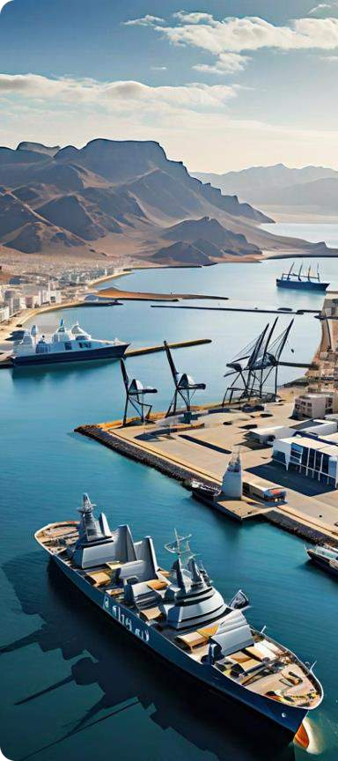
Djibouti's Strategic Importance
Military Hub
Djibouti hosts Arab coalition forces fighting in Yemen.
Shipping Chokepoint
Djibouti's location on the Gulf of Aden makes it a vital point for military and commercial navigation.
Contested Arena
Djibouti is a site of competition between Iran and Saudi Arabia for regional influence.

Slide 30
Implications for Israel
Conflict in Yemen
The conflict in Yemen has ramifications for the security of of Israel and the Horn of Africa. Africa.
Ethiopia's Ties
Iran's growing influence in Ethiopia is a concern for Israel's historically strong ties with the country.
Shipping Security
Ensuring the security of vital shipping routes in the Red Sea Sea and Suez Canal is crucial for Israel.

Slide 31
Shifting Regional Dynamics
Iran's Influence
Iran is actively working to expand its regional hegemony through proxies and
and strategic alliances.
Saudi Arabia's Response
Saudi Arabia is seeking to counter Iran's influence and assert its own dominance in the region.
Israel's Interests
Israel, surrounded by adversaries, is closely monitoring the shifting power dynamics in the Red Sea area.

Slide 32
The Role of Egypt
Egypt's Strategic Position
Egypt controls the Suez Canal, a vital global trade route, and has influence in the Red Sea Sea region.
Egypt has transferred control of islands in the the Red Sea to Saudi Arabia, with Israel's approval.
Egypt's actions and alliances in the region will
will shape the ongoing power dynamics and
security concerns.
Relationship with Saudi Arabia
Implications for the Region

Slide 33
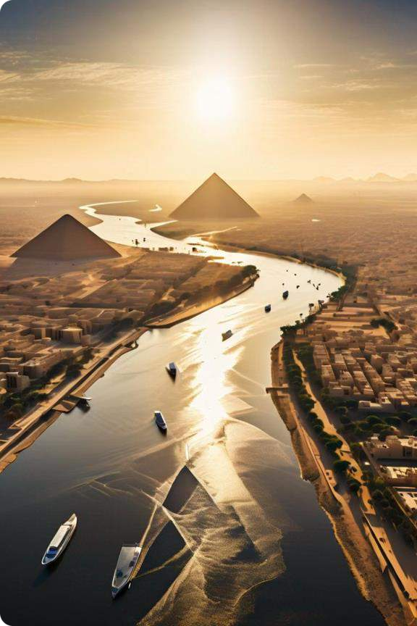
Egypt-Israel: The
Foundation of Middle Middle East Politics
Israel's strategic alliance with nations like Turkey and Iran, and its peace peace treaty with Egypt, have shaped the complex geopolitics of the Middle East.

Slide 34
Nasser's Pan-Arab Movement
1
Formidable Adversary
Nasser's revolutionary Pan-Arab movement posed a significant challenge for Israel.
2
The "Alliance with the Periphery"
Israel forged connections with Turkey, Turkey, Iran, and Ethiopia to counter Nasser's influence.
3
US Involvement
The US encouraged and and partially involved itself in these regional alliances against Nasser's Egypt and its Soviet allies.

Slide 35
Egypt's Shifting Relationships
Sadat's Peace with Israel
Egypt fostered a friendly relationship with Israel after the 1979 peace treaty, though constrained by the Palestinian-Israeli conflict. conflict.
Sisi's Collaboration
Under Sisi, military cooperation between Egypt and Israel has reached unprecedented unprecedented levels, with Egypt acting as a a mediator.
1
2
3
Mubarak's Stance
Mubarak opposed violence against Israel, but but the US supported the protesters against against his rule.

Slide 36
The Strait of Tiran Incident
Closure of the Strait
Egypt's closure of the Strait of Tiran, the sole sole shipping route to Eilat and Aqaba, played played a significant role in triggering the conflict with Israel.
Camp David Accords
The Camp David Accords ensured the freedom of navigation through the Strait, though Saudi Arabia was not a participant.

Slide 37
Egypt's Role in the Gaza Conflict
Blockade of Gaza
Mediator Role
Vital Security Interest
Egypt's involvement in the blockade of Gaza following the 2006 Hamas takeover demonstrated heightened cooperation between Egypt and Israel.
Sisi has acted as a mediator in the conflict between Hamas Hamas and Israel, despite regarding Hamas as an adversary.
The security of President Sisi is considered a vital security interest for Israel, according to the former head of the Mossad.

Slide 38
Egypt's Relationship with Iran
Improved Relations
Egypt has an improved relationship with Iran, with representatives from both nations participating in discussions.
Protecting the Suez
Canal
Egypt aims to foster closer ties with Iran to address issues like protecting the Suez Canal and ensuring safe passage through the Bab al-Mandab Strait.
Challenging Iran's
Ambitions
Egypt's control of the Red Sea and its friendly stance toward Iran's adversaries, Saudi Arabia and Israel, pose challenges for Iran's regional ambitions.

Slide 39
Egypt's Pivotal Role
King-Maker
Egypt has played the role of a king-maker, aligning with Israel Israel at times and at other times being ideologically at odds.
Vital for Israel's Security
For Israel to maintain its security, Egypt is a preferred friend rather than foe.
Assurance for Regional Peace
Egypt's role as a support for Israel provides tentative assurance for the prevalence of regional peace.

Slide 40
The Arab Spring and Egypt's Future
Successful Transition to Democracy
Could pave the way for a new era in the Arab world
Improbable that the rest of the region will
progress without Egypt
Reversion to Dictatorship

Slide 41
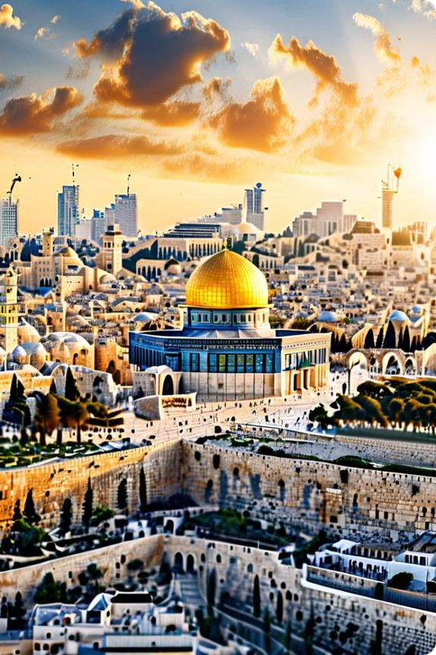
Israel-Saudi Arabia: A A Promising
Relationship?

Slide 42
Shared Adversary: Iran
1
Mutual Concern
Israel and Saudi Arabia worry about Iran's regional ambitions
2
Counter Efforts
Cooperating to mitigate Iranian influence in the Middle East
3
Combating Islamism
Shared priority to suppress organized Islamist opposition groups

Slide 43
Security Cooperation
US Arms Transfers
Strengthening Ties
Challenges Ahead
Saudi Arabia receives advanced US weapons to counter threats
Includes air defense systems,
systems, missiles, and other capabilities
Relationship with Israel helps helps Saudi Arabia's alliance with the US
Concerns over nuclear proliferation and technology technology misuse
Provides access to US military technology and intelligence
Delicate balancing act between US, Israel, and Saudi interests

Slide 44
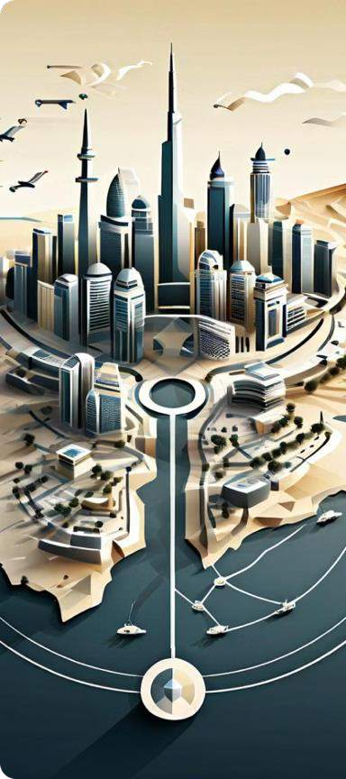
Balancing Regional Dynamics
1
Maintaining Influence
Saudi Arabia seeks to establish itself as the regional leader
2
Navigating Tensions
Reconciling Israel's relationship with the Palestinian cause
3
Ensuring Stability
Preventing the Middle East from descending into further chaos

Slide 45
Challenges for Israel
Palestinian Solidarity
Saudis must balance ties with Israel and Palestinian support
Perception and Backlash
Normalization with Israel could face criticism criticism in the Arab world
Securing Guarantees
Israel seeks Saudi security commitments and nuclear cooperation
Navigating Complexities
Intricate web of regional rivalries and historical grievances

Slide 46
Shifting Alliances
Geopolitical
Realignment
Evolving relationships relationships between between key players in the region
Forging New
Partnerships
Israel and Saudi Arabia explore avenues for cooperation
Balancing
Interests
Navigating complex web of rivalries and historical tensions
Potential
Flashpoints
Sudden changes and instability remain a constant threat

Slide 47
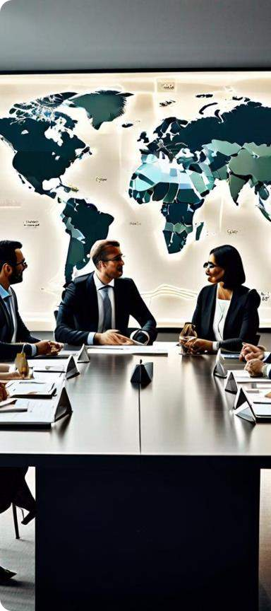
A Delicate Balancing Act
Diplomatic Finesse
Navigating the complex Middle Eastern geopolitics
Nuanced Analysis
Understanding the intricate web of relationships and interests
Mitigating Risks
Preventing unintended consequences and sudden changes

Slide 48
A Promising, but Challenging, Relationship
Shared Interests | Mutual Concerns | Potential Obstacles
Countering Iranian influence | Combating Islamist opposition | Palestinian solidarity and support
Strengthening ties with the US | Ensuring regional stability | Securing guarantees and commitments
Exploring new avenues for cooperation | Navigating complex geopolitical dynamics | Perception and backlash in the Arab world

Slide 49
Israel and the Middle East Coalition
The Middle East has seen the rise of various coalitions, with countries like Saudi Arabia, Iran, and Turkey, each with its own priorities and concerns. This presentation explores the complex dynamics shaping the region's relationships and their implications for Israel.

Slide 50
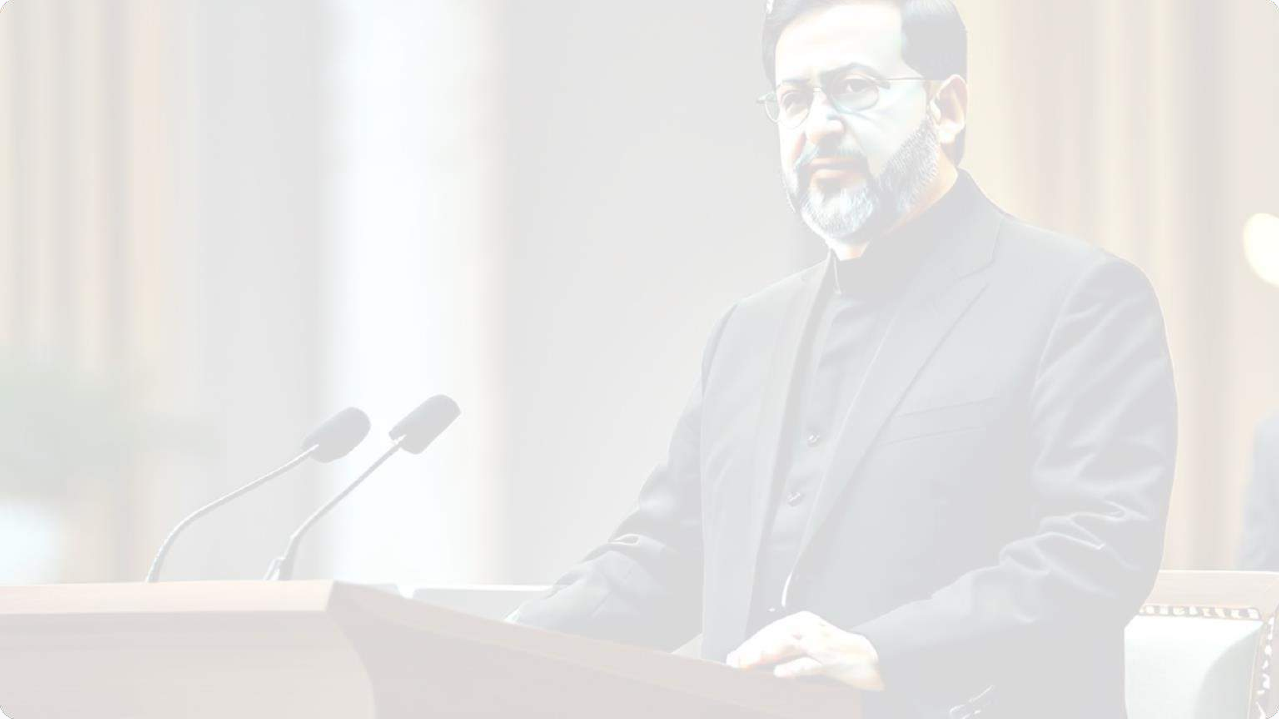
Iran's Influence and Aggression
Iran has been a key player in the region, supporting both state and non-state actors in their aggression towards Israel. President Raisi has warned Saudi Arabia against making deals with Israel, emphasizing the importance of the Palestinian cause for all Muslims.

Slide 51
Egypt's Shifting Alliances
Alignment with US
Egypt aligns more closely with the US, Israel's ally, than with Iran's sphere of influence.
Security Concerns
Egypt finds Iran appealing, especially in the security domain, to address issues like insurgency and terrorism.
Mediation Potential
Iran's connections with Ethiopia could help mediate Egypt's dispute over the Grand Ethiopian Renaissance Dam.
1

Slide 52
Turkey's Shifting Stance
Recognition
Turkey was the first Muslim- majority country to recognize Israel's sovereignty in 1949.
Changing Stance
The current Turkish president has called Hamas "freedom fighters" and Israel a "terror state".
Warnings
Erdoğan has warned Israel, saying, "You can have as many many nuclear bombs as you want, but you're on your way out."

Slide 53
Russia's Shifting Priorities
Constructive Relations
Scrutiny of Israel
Closer Ties with Iran
Russia had always enjoyed constructive relations with Israel.
Russia has grown increasingly scrutinizing of Israel's military activities, especially as they encroach upon its interests.
Russia has formed a close relationship with Israel's primary adversary, Iran, and has increasingly depended on on Tehran.

Slide 54
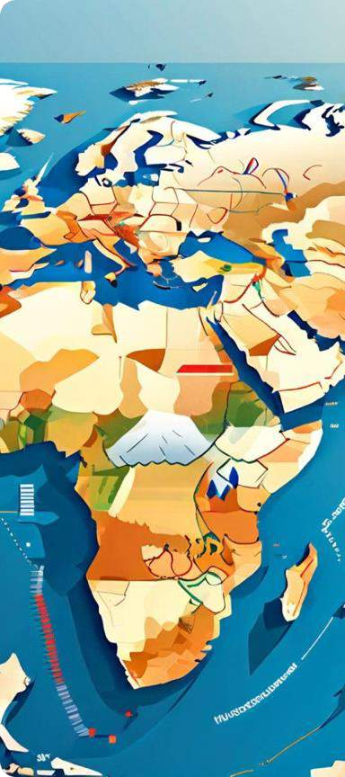
Coalitions and Alliances
Shifting Dynamics
The Middle East's complex geopolitical geopolitical landscape has led to the formation of various coalitions and alliances.
Competing Interests
These coalitions often emerge as a response to shifting regional challenges and the pursuit of economic economic and security objectives.
Implications for Israel
Understanding the dynamics behind these coalitions is crucial for comprehending the
the broader regional context and its impact on Israel.

Slide 55
Challenges and Complexities
Ethnicity and Religion
Ethnic and religious dynamics exert significant influence on events in the
Middle East.
Histories and Alliances
Current agreements, alliances, and recent events all contribute to the direction taken by respective state and non-state identities.
Deadly Weapons
The availability of deadly weapons is another complicating and incendiary factor in the region.

Slide 56
Seeking Peace and Security
1
Rules-based Order
Acknowledging a rules-based order is a starting point for establishing peace and security in the region.
2
Global Significance
The Middle East is globally significant, with oil, maritime access, access, and the nations of the region making it a crucial area.
3
Goodwill and Compromise
Recognizing the end game strategy and putting aside self-seeking is essential for
for finding solutions in the region.

Slide 57
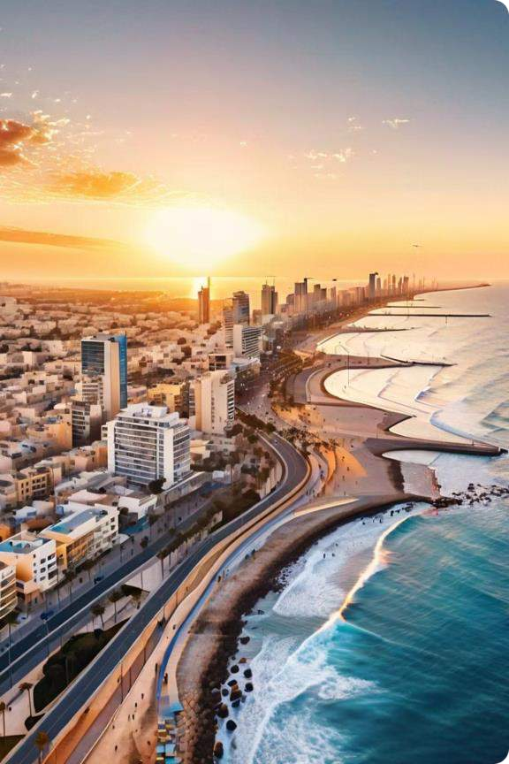
Conclusion
Israel's Precarious Future
Israel faces mounting threats from Iran and its proxies, as well as the challenge of acceptance by its Arab neighbors.

Slide 58
Threats from Iran
1
Ballistic Missile Program
Iran's ballistic missile program poses poses a significant threat to Israel.
2
Proxy Attacks
Iran supports groups like Hamas and Hezbollah, which oppose Israel's existence.
3
Anti-Israel Rhetoric
Iranian leaders have made strong anti-Israel statements.

Slide 59
Alliances and Cooperation
America's Support
The "Alliance with the Periphery"
Potential Alliances
The alliance with the US is crucial for Israel's survival.
Normalization of relations with with Saudi Arabia and Russia Russia could be beneficial for for Israel.
Israel has forged strategic alliances with nations like Turkey, Iran, and Ethiopia.

Slide 60
Challenges and Uncertainties
1
Transferred Hatred
Israel faces proxy wars and transferred aggression due to its alliance with the US.
2
Permanent Acceptance
Achieving lasting acceptance by its Arab neighbors remains an elusive goal.
3
Shifting Alliances
Alliances and cooperation are not permanent and can change based on
interests.

